Slide 1

IBM HR Analytics
for
Employee Attrition and Performance Prediction
Presented by -
Swati

Slide 2

Introduction
Objective
System Architecture
Dataset Info
Implementation
Conclusion

Slide 3

Introduction
HR analytics is the process of collecting and analyzing Human Resource (HR) data in order to improve an organization’s workforce performance. The process can also be referred to as talent analytics, people analytics, or even workforce analytics.
This method of data analysis takes data that is routinely collected by HR and correlates it to HR and organizational objectives. Doing so provides measured evidence of how HR initiatives are contributing to the organization’s goals and strategies.

Slide 4

OBJECTIVE
Employee attrition is the rate at which employees leave a company. The goal of this analysis is to model employee attrition and determine the most dominant contributing factors that govern this turnover. Through this kind of analysis, we can understand how many employees are likely to leave, while also determining which employees are at the highest risk and for what reasons.

Slide 5
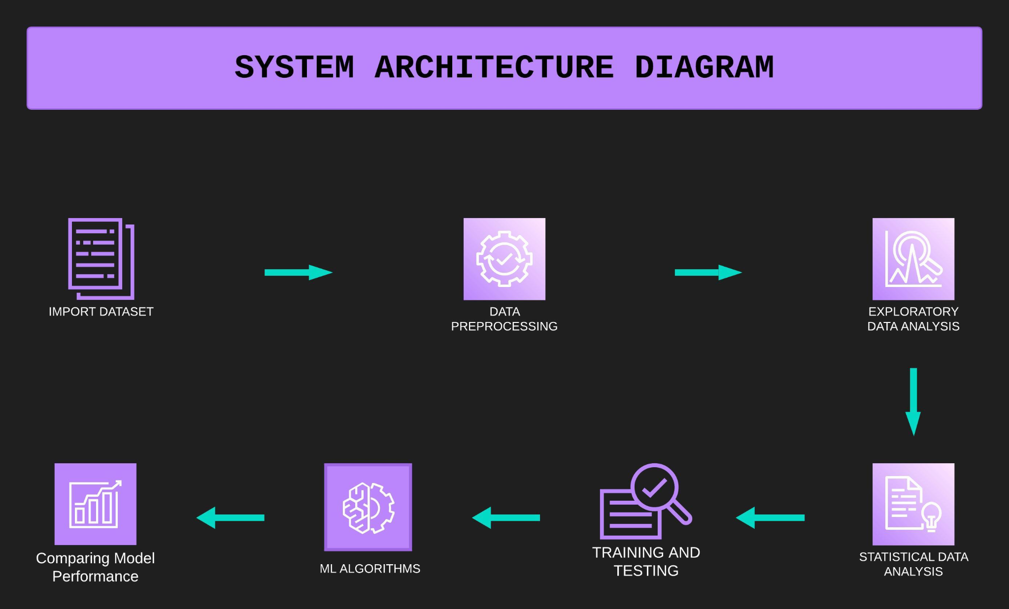

Slide 6
DATASET
This is a hypothetical dataset created by IBM data scientists. The dataset has (1470R X 35C) that contains numeric and categorical data types describing each employee’s background and characteristics, and labeled with whether they are still in the company or whether they have gone to work somewhere else.
01] Age
02] Attrition
03] BusinessTravel
04] YearsWithCurrManage
05] Department
06] DistanceFromHome
07] Education
08] EducationField
09] EmployeeCount
10] EmployeeNumber
11] EnvironmentSatisfaction
12] Gender
13] JobInvolvement
14] JobLevel
15] JobRole
16] JobSatisfaction
17] MaritalStatus
18] NumCompaniesWorked
19] Over18
20] PercentSalaryHike
21] PerformanceRating
22] RelationshipSatisfaction
23] StandardHours
24] StockOptionLevel
25] TotalWorkingYears
26] TrainingTimesLastYear
27] WorkLifeBalance
28] YearsAtCompany
29] YearsSinceLastPromotion

Slide 7
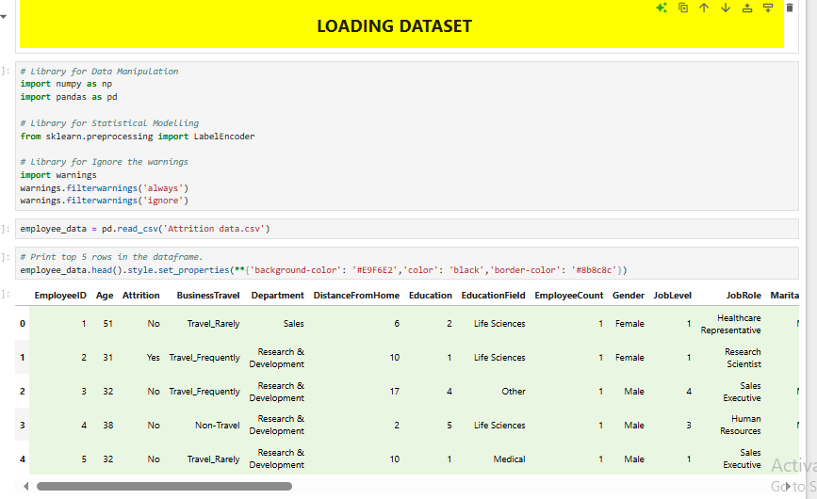
IMPLEMENTATION
ABOUT DATASET

Slide 8
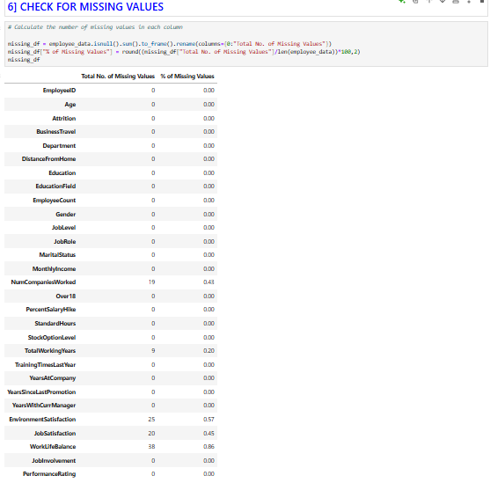
CHECK FOR MISSING VALUES

Slide 9
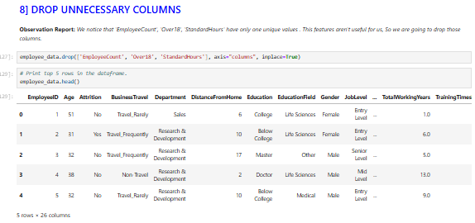
DROP UNNECESSARY VALUES

Slide 10

Predictive Insights for Employee Attrition
By analyzing employee data, we can identify factors that contribute to employee attrition, such as job satisfaction, compensation, and work-life balance. This information can be used to develop strategies to retain top talent and reduce turnover rates.

Slide 11
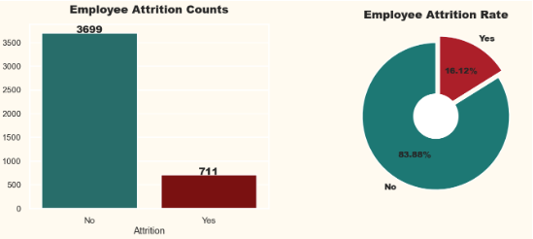
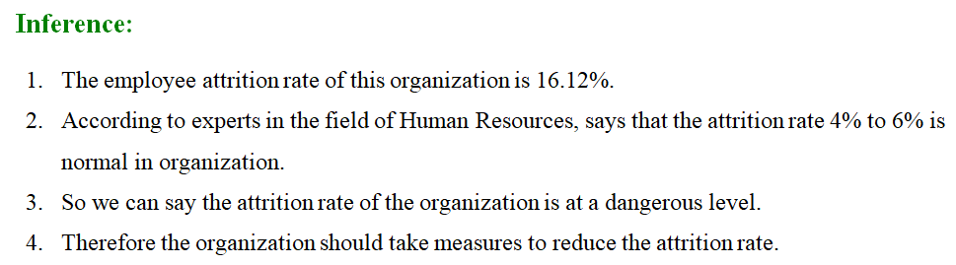
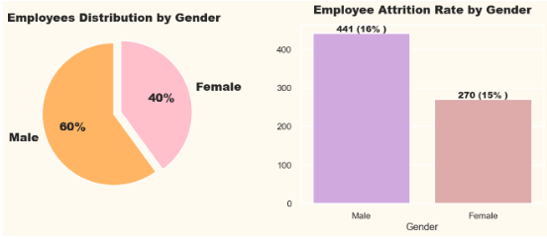
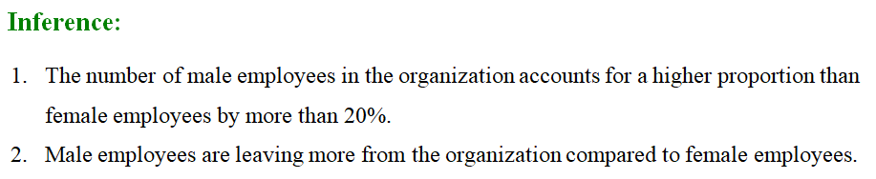

Slide 12
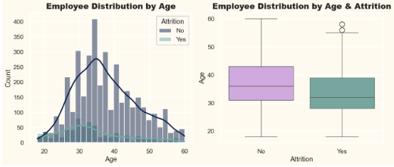
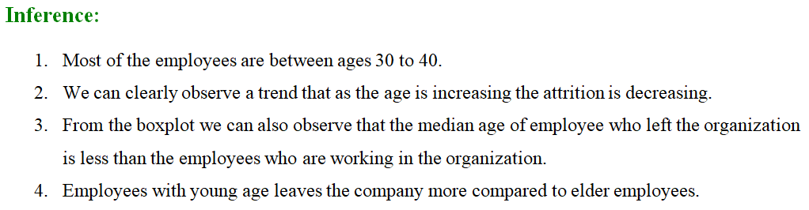
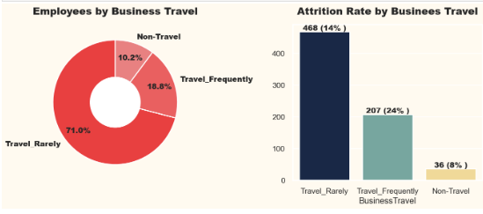
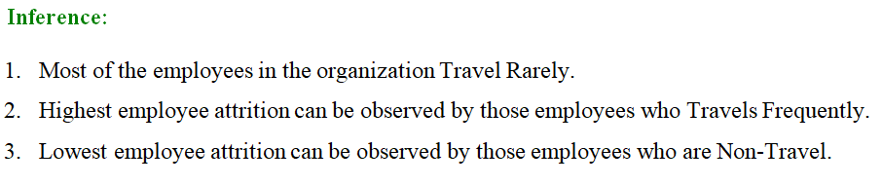

Slide 13
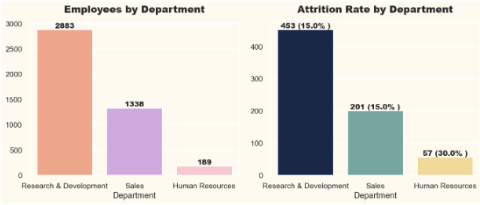
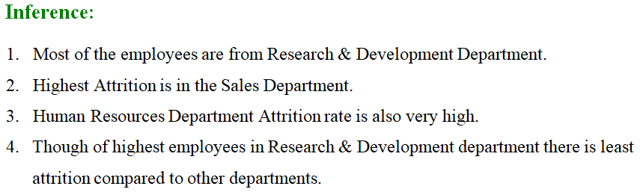
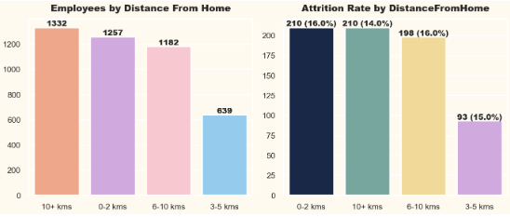
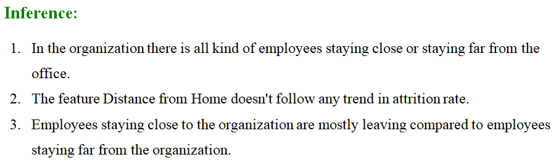

Slide 14
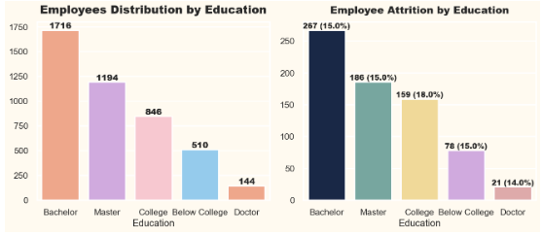
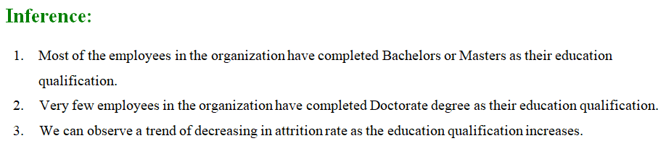
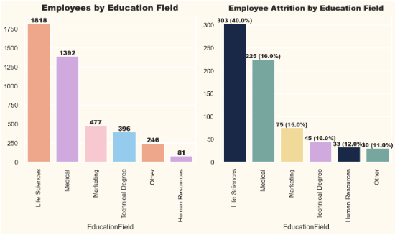
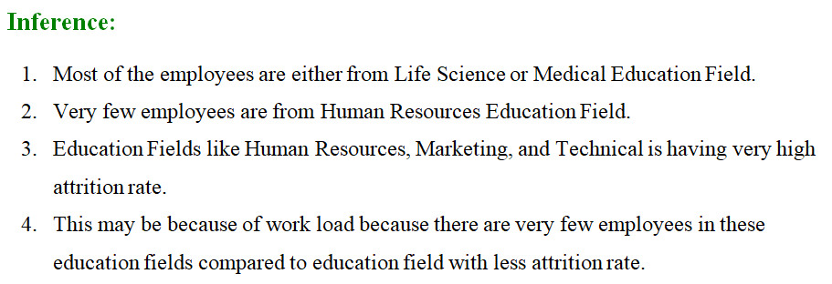

Slide 15
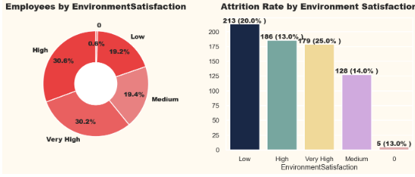
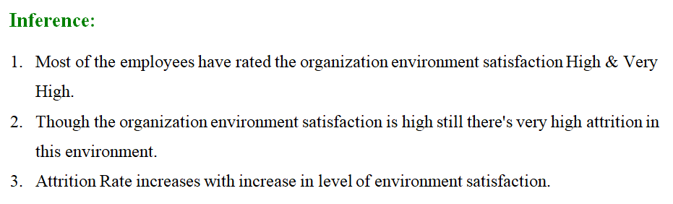
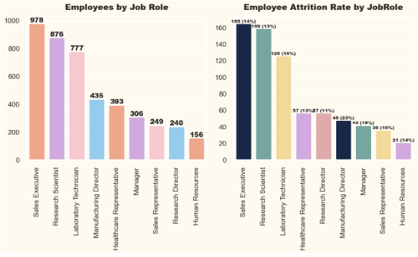
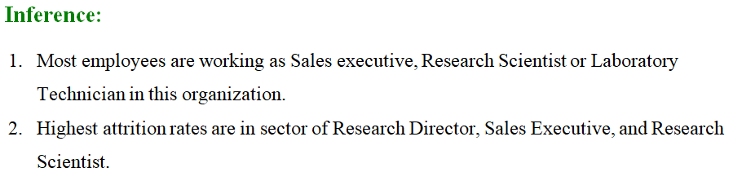

Slide 16
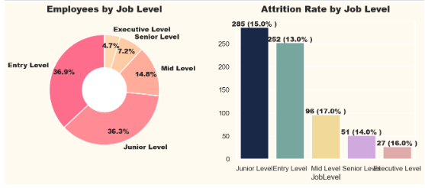
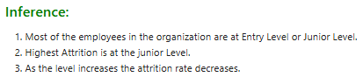
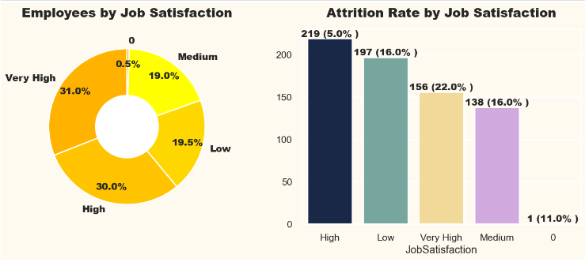
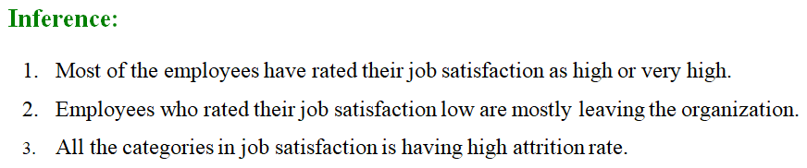

Slide 17
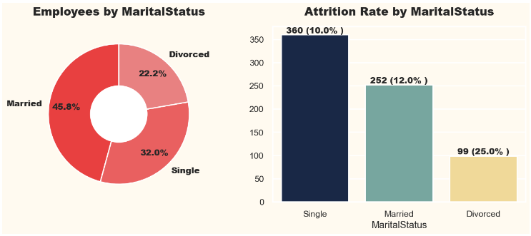
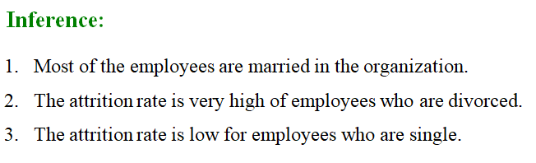
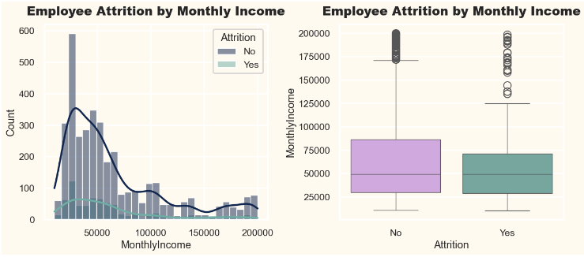
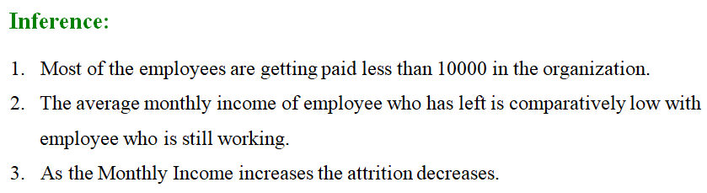

Slide 18
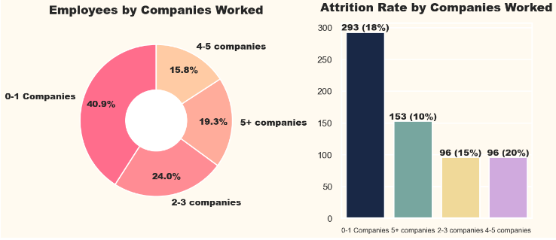
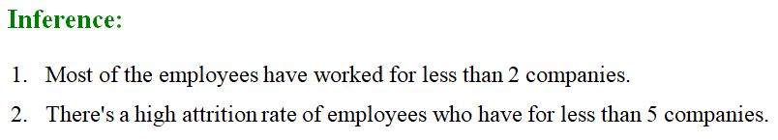
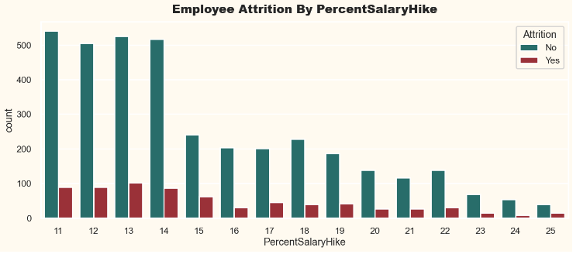
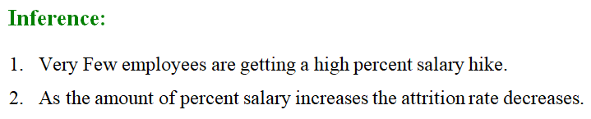

Slide 19
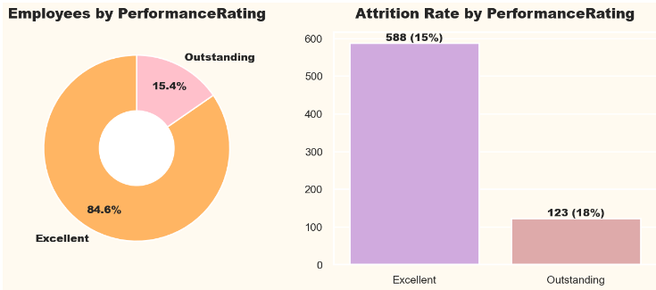
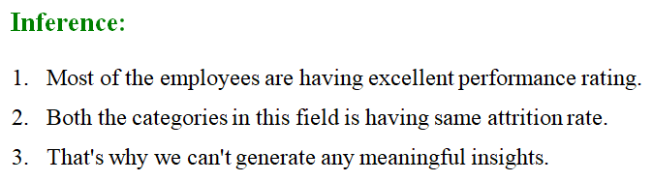
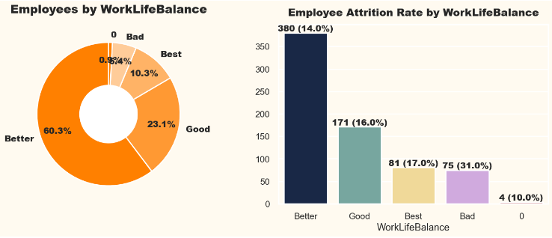
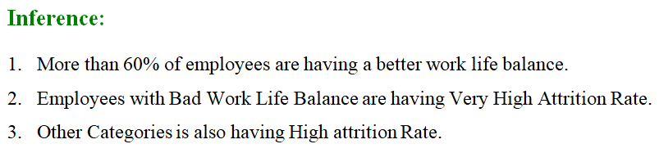

Slide 20
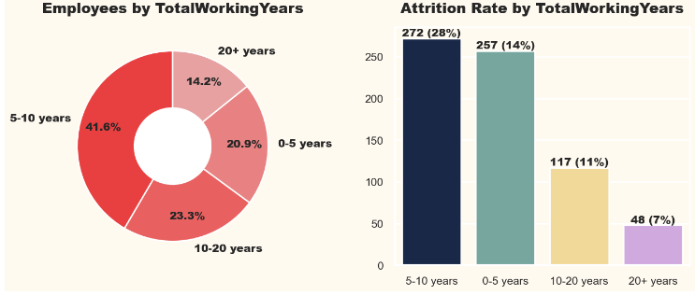
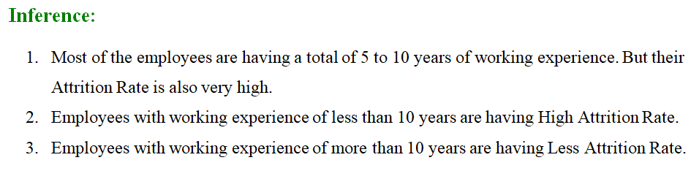
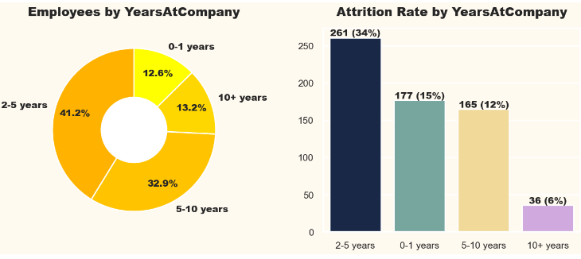
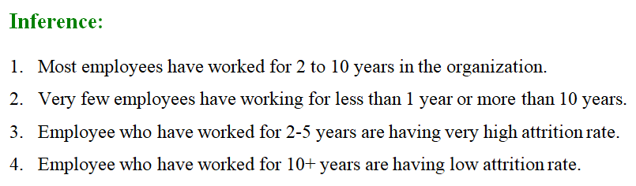

Slide 21
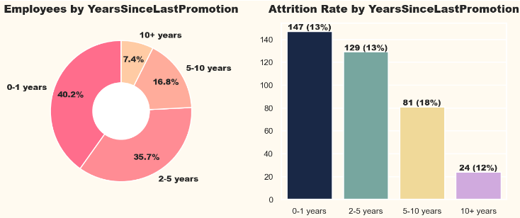
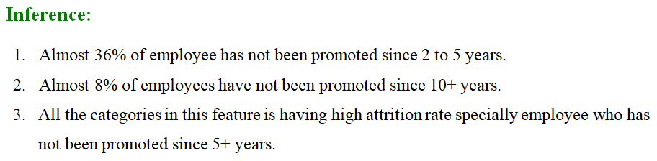
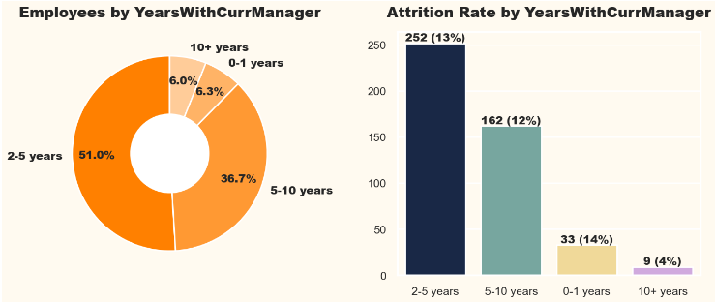
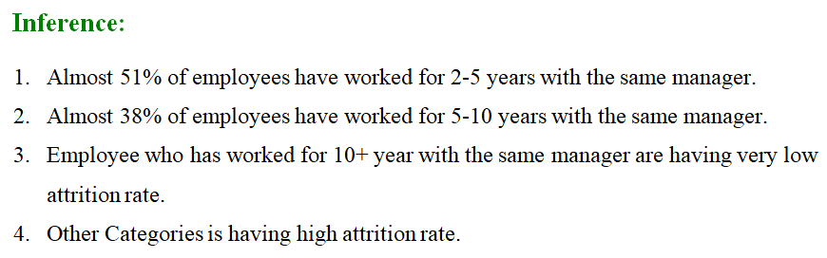

Slide 22
Conclusion
In conclusion, we embarked on a comprehensive analysis of the IBM HR Analytics Attrition Dataset, from data loading to model evaluation. By implementing and evaluating various machine learning algorithms, we gained insights into which models are effective for predicting employee attrition. The results and visualizations generated throughout the process provide valuable information for decision-makers and HR professionals seeking to understand and mitigate employee attrition within the organization. This project showcases the power of data analysis and machine learning in addressing real-world business challenges.

Slide 23
THANKS

